Slide 1

Online Job Portal
GROUP MEMBERS
HARSH CHAUHAN
HARSH AWASTHI
Department of Computer Applications,
KIET Group of Institutions,
Delhi-NCR, Ghaziabad

Slide 2
ABSTRACT
Job portal service was developed for creating an interactive job vacancy form for candidates. This web application manage updates both from the job seekers as well as the companies. It’s unique development methodology helps in acquiring the client and candidate information and separating them according to the job requirements and vacancies. The online access to it provides details of the job. An employer being registered in the web site has the facility to use the services. Being an authorized user he can publish vacancy details and can search no of Employees on portal and also he can search candidates on basis of the key skill which employee provides on registration.

Slide 3
Table of Contents
1. Introduction
2. Technologies / Software Requirements
3. Hardware requirement / Hardware Used
4. Modules Description
5. Reports / Outputs
6. Conclusion
7. How to serve the society (If applicable)
8. Gantt Chart (In terms of weeks)

Slide 4
Introduction
The job portal project is an online platform that is designed to help job seekers find suitable employment and to provide employers with access to a larger pool of qualified candidates. With the increasing use of the internet and technology in everyday life, job seekers are increasingly turning to online job portals to find employment. These portals offer a convenient and efficient way for job seekers to search for job openings, create and manage their profiles, and apply for job listings. Similarly, employers are also turning to these portals to post job openings, review resumes and cover letters, and communicate with potential candidates.

Slide 5
Software requirements
Operating System
Windows 7 & above,
Linux Code Editor
Visual Studio Code

Slide 6
Hardware requirement
Processor intel i35th generation or higher
Installed memory (RAM)
1 GB (further increase that as per requirement.) Hard disk requirement
80 GB (further increase that as per requirement.)

Slide 7
Modules Description
Applicant Module
Job Category Module
Company Module
Location Module
Feedback

Slide 8
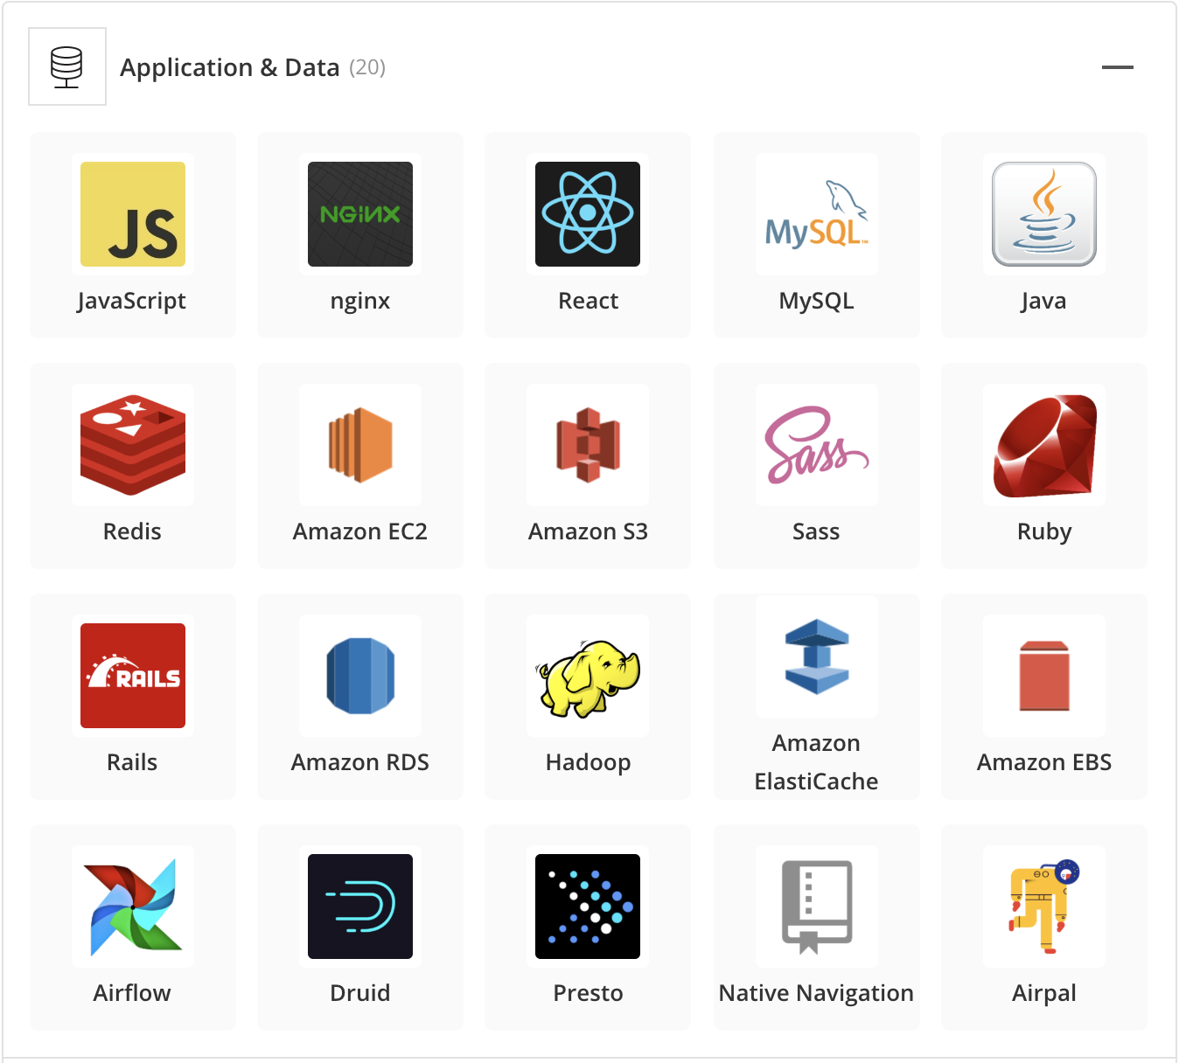
Technology stack
MongoDB : Document-oriented NoSQL database for storing user and job data
Express.js : Web Application framework for building robust backend APIs.
React.js : JavaScript library for creating dynamic and interactive user interfaces.
Node.js : Server-side JavaScript runtime environment for executing JavaScript code outside the browser.

Slide 9

Reports
This module contains all the information about the reports generated
by the admin based on the particular job seeker, particular job
provider, all job seeker and job provider, all jobs generated by the
job providers

Slide 10
Conclusion
It has been a great pleasure for me to work on this exciting and challenging project. This project proved good for me as it provided practical knowledge of not only programming in Php , MySql ,
React, HTML,CSS web based application and no some extent Windows Application and SQL Server, but also about all handling procedure related with “JOB PORTAL”. It also provides knowledge about the latest technology used in developing web enabled application and client server technology that will be great demand in future. This will provide better opportunities and guidance in future in developing projects independently.

Slide 11
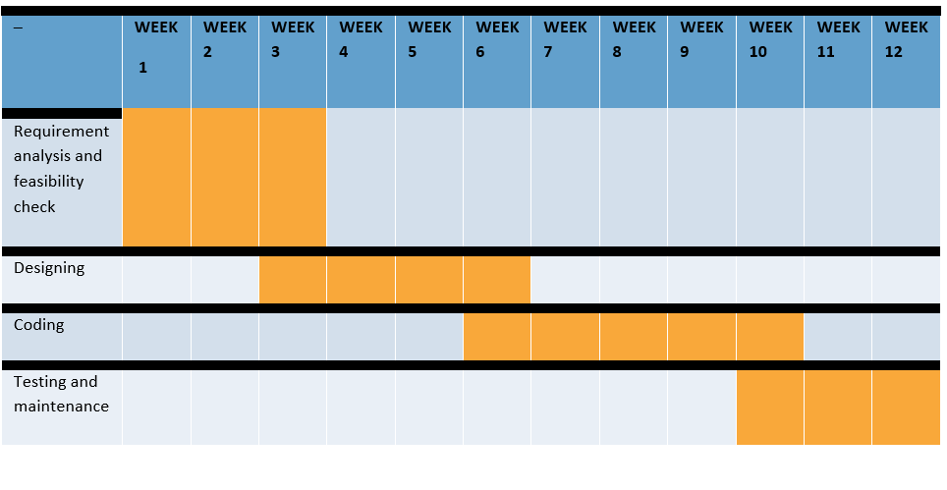
2

Slide 12
THANK YOU!

